Slide 1
Concurrency Control

Slide 2
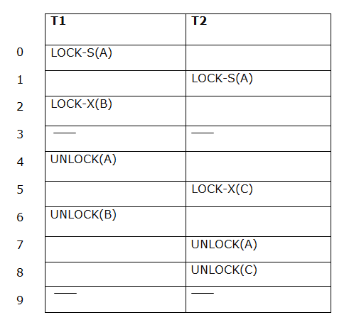
2 PL Example
Transaction T1:
Growing phase: from step 1-3
Shrinking phase: from step 5-7
Lock point: at 3
Transaction T2:
Growing phase: from step 2-6
Shrinking phase: from step 8-9
Lock point: at 6

Slide 3
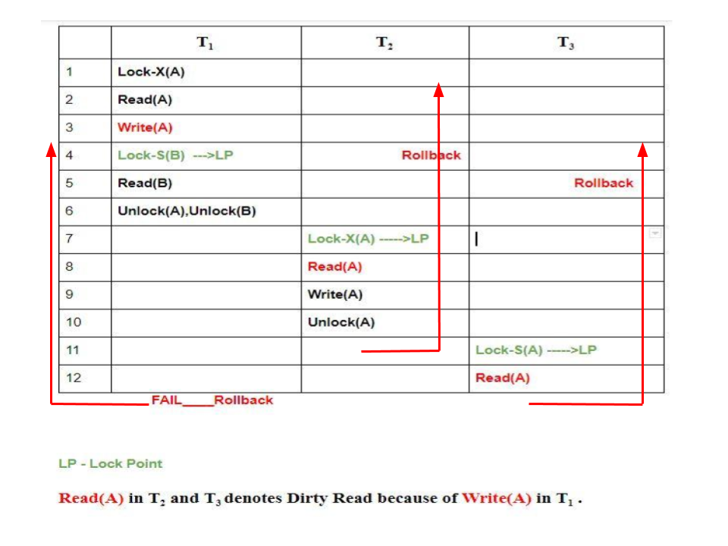
2 PL
2-PL ensures serializablity, some drawbacks of 2-PL are
Cascading Rollback is possible under 2-PL.
Deadlocks and Starvation is possible

Slide 4
 | T₁ | T₂
1 | Read(A)
2 |  | Read(A)
3 | Read(B)
4 | Write(B)
5 | Commit
6 |  | Read(B)
7 |  | Write(B)
6 |  | Commit
tell me if this schedule can be locked using 2-PL and if yes, show how and what class of 2-PL does your answer belongs?

Slide 5
Solution
 | T₁ | T₂
1 | Lock-S(A)
2 | Read(A)
3 |  | Lock-S(A)
4 |  | Read(A)
5 | Lock-X(B)
6 | Read(B)
7 | Write(B)
8 | Commit
9 | Unlock(A)
10 | Unlock(B)
11 |  | Lock-X(B)
12 |  | Read(B)
13 |  | Write(B)
14 |  | Commit
15 |  | Unlock(A)
16 |  | Unlock(B)
satisfies Rigorous 2-PL protocol.

Slide 6
Non-2PL, A= 1000, B=2000, Output =?
T1
T2
Lock_X(A)
Read(A) | Lock_S(A)
A: = A-50
Write(A)
Unlock(A)
 | Read(A)
 | Unlock(A)
 | Lock_S(B)
Lock_X(B)
 | Read(B)
 | Unlock(B)
 | PRINT(A+B)
Read(B)
B := B +50
Write(B)
Unlock(B)

Slide 7
2PL, A= 1000, B=2000, Output =?
T1
T2
Lock_X(A)
Read(A) | Lock_S(A)
A: = A-50
Write(A)
Lock_X(B)
Unlock(A)
 | Read(A)
 | Lock_S(B)
Read(B)
B := B +50
Write(B)
Unlock(B) | Unlock(A)
 | Read(B)
 | Unlock(B)
 | PRINT(A+B)

Slide 8
Strict 2PL, A= 1000, B=2000, Output =?
T1
T2
Lock_X(A)
Read(A) | Lock_S(A)
A: = A-50
Write(A)
Lock_X(B)
Read(B)
B := B +50
Write(B)
Unlock(A)
Unlock(B)
 | Read(A)
 | Lock_S(B)
 | Read(B)
 | PRINT(A+B)
 | Unlock(A)
 | Unlock(B)

Slide 9
Timesstamp- Based Protocols
Each transaction is issued a timestamp when it enters the system. If an older transaction T_{i} has time-stamp TS(T_{i}), a younger transaction T_{j} is assigned time-stamped TS(T_{j}) such that TS(T_{i}) < TS(T_{j}).
The protocol manages concurrent execution such that the time-stamps determine the serializability order.
For each data item Q, two timestamps are maintained:
  W-timestamp(Q) is the largest time-stamp of any transaction that executed write(Q) successfully.
  R- timestamp(Q) is the largest time-stamp of any transaction that executed read(Q) successfully.
Data
items
TS(T1)
W-TS(Q), R-TS(Q)
T1
W-TS(R), R-TS(R)
TS(T2)
T2
W-TS(S), R-TS(S)

Slide 10
Timestamp-Based Protocol
The timestamp ordering protocol ensures that any conflicting read and write operations are executed in timestamp order.
Suppose a transaction T_{i} issues a read(Q)
  If TS(T_{i}) < W-timestamp(Q)
    T_{i} wants to read a value of Q that has been written by a “younger” transaction
    Hence, the read operation is rejected, and T_{i} is rolled back.
  If TS(T_{i}) ≥ W-timestamp(Q)
    then the read operation is executed
    R-timestamp(Q) is set to the maximum of R-timestamp(Q) and TS(T_{i}).

Slide 11
Timestamp-Based Protocol
Suppose that transaction T_{i} issues write(Q).
  If TS(T_{i}) < R-timestamp(Q)
    Q is already read by a “younger” transaction
    if T_{i} writes to Q, then it may conflict with this younger transaction
    Hence, the write operation is rejected, and T_{i} is rolled back.
  If TS(T_{i}) < W-timestamp(Q)
    T_{i} is attempting to write an obsolete value of Q since a “newer” value has already been written onＱ
    Hence, this write operation is rejected, and T_{i} is rolled back.
  Otherwise, the write operation is executed, and W-timestamp(Q) is set to TS(T_{i}).

Slide 12
Example Use of the Protocol
A partial schedule for transactions with timestamp 1, 2, 3, 4, 5
T1
T2
T3
T4
T5
Read(X)
Read(Y)
√
√
Read(Y)
√
Write(Y)
√
Write(Z)
x
Read(Z)
Read(Z)
√
√
abort
x
Read(X)
√
Write(Z)
abort
Write(X)
Write(Z)
Aborted transactions are restarted with new timestamps

Slide 13
Correctness of Timestamp-Ordering Protocol
The timestamp-ordering protocol guarantees serializability since all the arcs in the precedence graph are of the form:
Thus, there will be no cycles in the precedence graph
Timestamp protocol ensures freedom from deadlock as no transaction ever waits.
But the schedule may not be cascade-rollback-free, and may not even be recoverable.
Transaction
with smaller/older
timestamp
Transaction
with larger/younger
timestamp

Slide 14
Recoverability and Cascade Freedom
Problem with timestamp-ordering protocol:
  Suppose T_{i} aborts, but T_{j} has read a data item written by T_{i}
  Then T_{j} must abort; if T_{j} had been allowed to commit earlier, the schedule is not recoverable.
  Further, any transaction that has read a data item written by T_{j} must abort
  This can lead to cascading rollback --- that is, a chain of rollbacks
Solution 1:
  A transaction is structured such that its writes are all performed at the end of its processing
  All writes of a transaction form an atomic action; no transaction may execute while a transaction is being written
  A transaction that aborts is restarted with a new timestamp
Solution 2: Limited form of locking: wait for data to be committed before reading it
Solution 3: Use commit dependencies to ensure recoverability

Slide 15
Thomas’ Write Rule
Modified version of the timestamp-ordering protocol in which obsolete write operations may be ignored under certain circumstances.
When T_{i} attempts to write data item Q, if TS(T_{i}) < W-timestamp(Q), then T_{i} is attempting to write an obsolete value of {Q}.
  Rather than rolling back T_{i} as the timestamp ordering protocol would have done, this {write} operation can be ignored.
Otherwise this protocol is the same as the timestamp ordering protocol.
Thomas' Write Rule allows greater potential concurrency.
  Allows some view-serializable schedules that are not conflict-serializable.

Slide 16
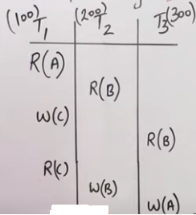
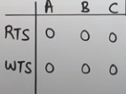
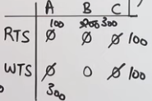
Time Ordering Protocol Example
Which Transaction will rollback first?

Slide 17
Dealing with Deadlock
Deadlocks tend to be rare, and involve only a few transactions
Common approach:
  Lock manager maintains “waits-for” graph, and periodically checks for cycles
  If a cycle is detected, abort some transaction to break the cycle (and relinquish its locks)
If a transaction doesn’t complete within some fixed amount of time, assume it is deadlocked, and abort
Also deadlock prevention techniques

Slide 18
Deadlock Handling
Consider the following two transactions:
T₁: write (X) T₂: write(Y)
write(Y) write(X)
Schedule with deadlock
T₁
T₂
lock-X on X
write (X)
lock-X on Y
write (X)
wait for lock-X on X
wait for lock-X on Y

Slide 19
Deadlock Handling
System is deadlocked if there is a set of transactions such that every transaction in the set is waiting for another transaction in the set.
Deadlock prevention protocols ensure that the system will never enter into a deadlock state.
Deadlock detection & recovery: protocols allow system to enter into a deadlock, detect them as quickly as possible & recover from it by rolling back one or more txs.

Slide 20
Deadlock Handling
Deadlock prevention protocols ensure that the system will never enter into a deadlock state. Some prevention strategies :
  Require that each transaction locks all its data items before it begins execution (predeclaration).
  Impose partial ordering of all data items and require that a transaction can lock data items only in the order specified by the partial order (graph-based protocol).

Slide 21
More Deadlock Prevention Strategies
Following schemes use transaction timestamps for the sake of deadlock prevention alone.
wait-die scheme — non-preemptive
  older transaction may wait for younger one to release data item. Younger transactions never wait for older ones; they are rolled back instead.
  a transaction may die several times before acquiring needed data item
wound-wait scheme — preemptive
  older transaction wounds (forces rollback) of younger transaction instead of waiting for it. Younger transactions may wait for older ones.
  may be fewer rollbacks than wait-die scheme.

Slide 22
Deadlock Prevention - Timestamps
When T_{i} wants an item locked by T_{j,} one of the following two rules can be used to avoid deadlock:
wait-die rule: if TS(T_{i}) < TS(T_{j})
T_{i} waits
else T_{i} aborts and restarts with same TS
wound-die rule: if TS(T_{i}) < TS(T_{j})
T_{j} aborts and restarts with same TS
else T_{i} waits
Prevent deadlocks but abort transactions which are not in deadlock
A transaction my be aborted many times because an older transaction holds an item for a long period of time (need delay in restart)
Restarted transactions retain their original “seniority” to avoid starvation

Slide 23
Deadlock prevention (Cont.)
Both in wait-die and in wound-wait schemes, a rolled back transactions is restarted with its original timestamp. Older transactions thus have precedence over newer ones, and starvation is hence avoided.
Timeout-Based Schemes :
  a transaction waits for a lock only for a specified amount of time. After that, the wait times out and the transaction is rolled back.
  thus deadlocks are not possible
  simple to implement; but starvation is possible. Also difficult to determine good value of the timeout interval.

Slide 24
Deadlock Detection Techniques
Transactions are allowed to proceed freely, but system periodically checks if deadlock has occurred and fixes it if deadlock is detected
Good for short transactions that lock only a few items
Method: construct a wait-for graph by drawing an edge from T_{i} to T_{j} if T_{i} is waiting for an item locked by T_{j}
Problems:
  How often should the system checks deadlock?
  If a deadlock is detected, which transaction should be aborted? (should select short transactions involved in multiple deadlocks)
  Cyclic restart: when a transaction is aborted and restarted, it is involved in another deadlock (e.g., due to transactions accessing same data items with the same pattern); random delays can be introduced in restart

Slide 25
Deadlock Detection
Deadlocks can be described as a wait-for graph, which consists of a pair G = (V,E),
  V is a set of vertices (all the transactions in the system)
  E is a set of edges; each element is an ordered pair T_{i} →T_{j}.
If T_{i} → T_{j} is in E, then there is a directed edge from T_{i} to T_{j}, implying that T_{i} is waiting for T_{j} to release a data item.
When T_{i} requests a data item currently being held by T_{j}, then the edge T_{i} T_{j} is inserted in the wait-for graph. This edge is removed only when T_{j} is no longer holding a data item needed by T_{i}.
The system is in a deadlock state if and only if the wait-for graph has a cycle. Must invoke a deadlock-detection algorithm periodically to look for cycles.

Slide 26


Deadlock Detection (Cont.)
Wait-for graph without a cycle
Wait-for graph with a cycle

Slide 27
Deadlock Detection (Continued)
Example:
T1: S(A), R(A), S(B)
T2: X(B),W(B) X(C)
T3: S(C), R(C) X(A)
T4: X(B)
T1
T2
T1
T2
T4
T3
T3
T3

Slide 28
Deadlock Recovery
When deadlock is detected :
  Some transaction will have to rolled back (made a victim) to break deadlock. Select that transaction as victim that will incur minimum cost.
  Rollback -- determine how far to roll back transaction
    Total rollback: Abort the transaction and then restart it.
    More effective to roll back transaction only as far as necessary to break deadlock.
  Starvation happens if same transaction is always chosen as victim. Include the number of rollbacks in the cost factor to avoid starvation

Slide 29
Deadlock Victim
Choose a deadlock victim based on the following parameters:
  How much work the tx. has done?
  How far is it from completion?
  How many resources (DIs) it is holding?
  How many txs. will be involved in the rollback
  How many times it has been rolled back?
  How many deadlocks it is involved in?

Slide 30
Locking Granularity
Hard to decide what granularity to lock (tuples vs. pages vs. tables).
why?

Slide 31
Multiple-Granularity Locks
Shouldn’t have to make same decision for all transactions!
Data “containers” are nested:
Database
Tables
contains
Pages
Tuples

Slide 32
Solution: New Lock Modes, Protocol
Database
Allow Xacts to lock at each level, but with a special protocol using new “intention” locks:
Still need S and X locks, but before locking an item, Xact must have proper intension locks on all its ancestors in the granularity hierarchy.
Tables
Pages
Tuples
IS – Intent to get S lock(s) at finer granularity.
IX – Intent to get X lock(s) at finer granularity.
SIX mode: Like S & IX at the same time. Why useful?

Slide 33
Multiple Granularity Lock Protocol
Database
Tables
Each Xact starts from the root of the hierarchy.
To get S or IS lock on a node, must hold IS or IX on parent node.
  What if Xact holds S on parent? SIX on parent?
To get X or IX or SIX on a node, must hold IX or SIX on parent node.
Must release locks in bottom-up order.
Pages
Tuples
Protocol is correct in that it is equivalent to directly setting
locks at the leaf levels of the hierarchy.

Slide 34
Lock Compatibility Matrix
Database
IS
IX
SIX
S
X
Tables
-
IS
√
√
√
√
Pages
-
-
-
IX
√
√
√
-
-
-
-
Tuples
SIX
S
√
-
-
√
-
-
-
-
-
-
IS – Intent to get S lock(s) at finer granularity.
IX – Intent to get X lock(s) at finer granularity.
SIX mode: Like S & IX at the same time.
X

Slide 35
Examples – 2 level hierarchy
Tables
T1 scans R, and updates a few tuples:
  T1 gets an SIX lock on R, then get X lock on tuples that are updated.
T2 uses an index to read only part of R:
  T2 gets an IS lock on R, and repeatedly gets an S lock on tuples of R.
T3 reads all of R:
  T3 gets an S lock on R.
  OR, T3 could behave like T2; can use lock escalation to decide which.
  Lock escalation dynamically asks for
  coarser-grained locks when too many
  low level locks acquired
Tuples
IS
IX
SIX
S
X
IS
√
√
√
√
IX
√
√
SIX
√
S
√
√
X

